Slide 1
Big Data Engineering NoSQL databases

Slide 2
Contents
Why NoSQL?
ReCAP
BigTable and Dynamo
A summary of a few NoSQL databases
MongoDB, Cassandra, Couchbase,

Slide 3
Why NoSQL?
Availability
Need better scaling capabilities
Elasticity
Different schema approaches
Graphs, Key Values, Document, Sparse Columns, etc
More appropriate balance in read/write performance
Better integration with REST/SOA/Cloud

Slide 4
NoSQL history
Not just a recent thing ☺
IBM IMS (Information Management System)
Launched in 1968
Used to store the bill of materials for the Saturn V rocket
Hierarchical model
Still in widespread use today

Slide 5
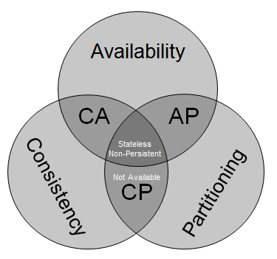
ReCAP
You can have 2 out of three:
Consistent
ACID
Available
HA / Accessible 24x7
Partitioned
Able to split into different datacentres
Survive network down
http://blog.mccrory.me/2010/11/03/cap-theorem-and-the-clouds/

Slide 6
NoSQL parents
Amazon Dynamo
Eventually consistent
Google BigTable
Supporting very large rows
LDM
Graph database

Slide 7
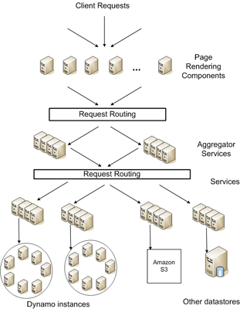
Dynamo

Slide 8
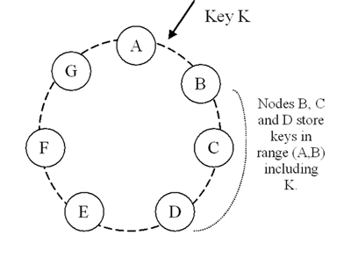
Dynamo Model
http://www.allthingsdistributed.com/2007/10/amazons_dynamo.html

Slide 9
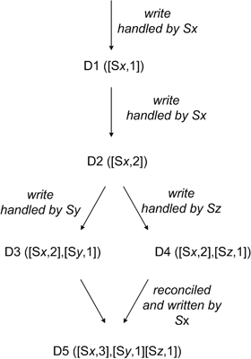
Reconciliation / Eventual Consistency
http://www.allthingsdistributed.com/2007/10/amazons_dynamo.html

Slide 10
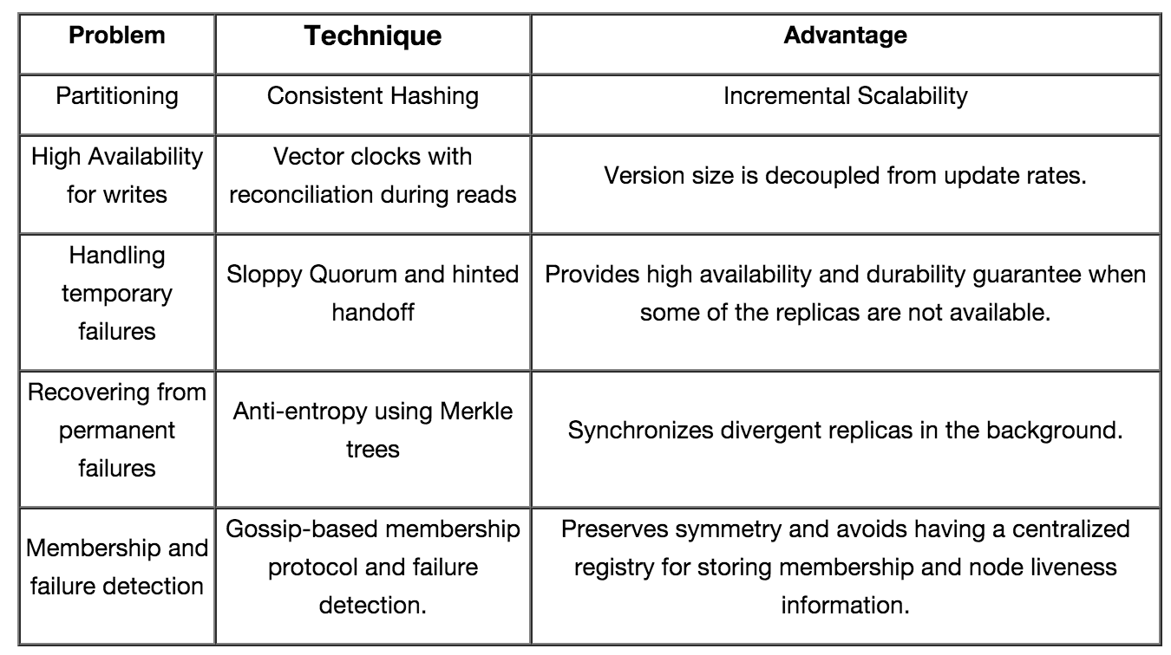
Dynamo Techniques

Slide 11
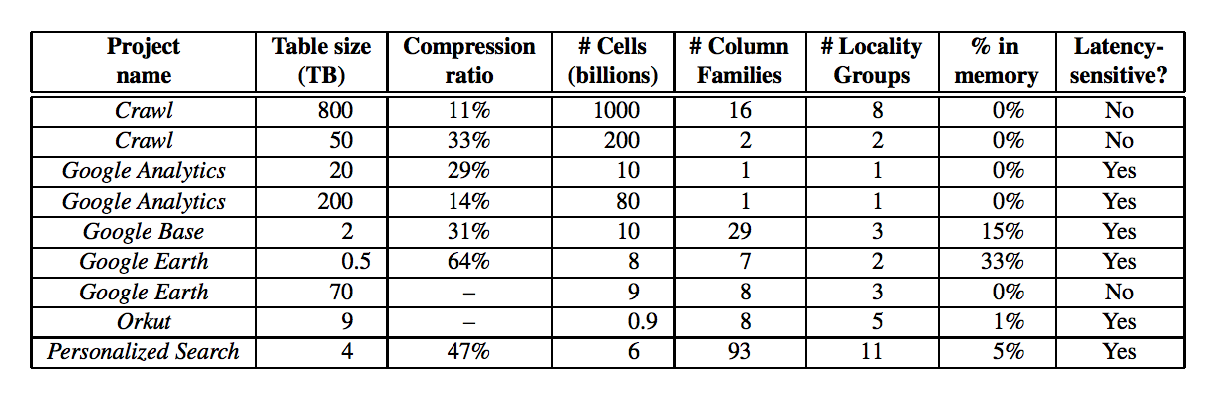
Google BigTable
Optimized to support very large data
Not just many rows, but rows that cannot fit into the memory of a single server
Column Families allow each row to live across servers
This table dates back to 2005

Slide 12
Current NoSQL Databases
Too many to list!
Popular databases include:
MongoDB
Couchbase
Apache Cassandra
Apache HBase
Voldemort
Redis
Riak
Etc, etc

Slide 13
“NewSQL”
ACID databases that aim to provide HA and Partition safety
VoltDB
NuoDB
Google Spanner
MemSQL
SAP HANA
Also there are some backend engines for MySQL that aim to provide this:
MySQL Cluster
TokuDB

Slide 14
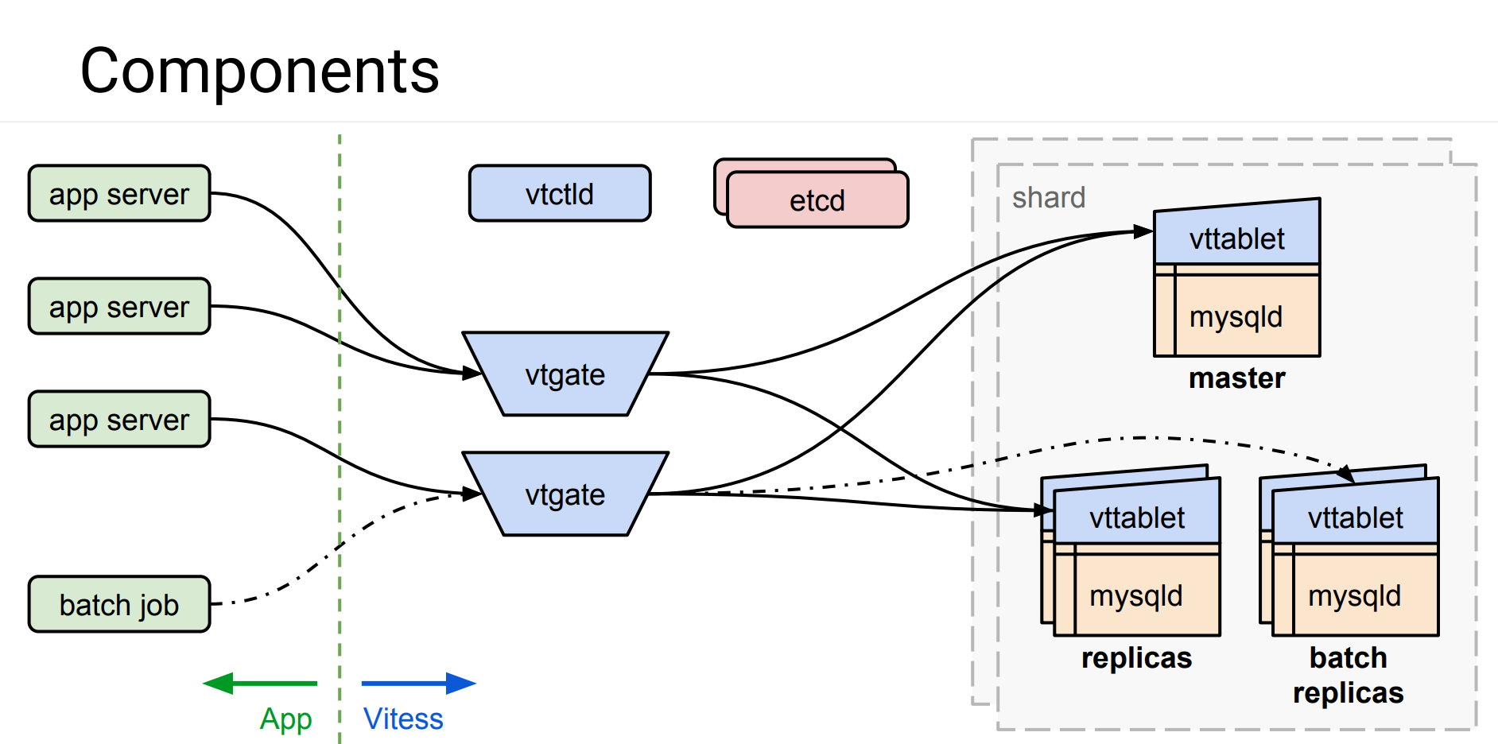
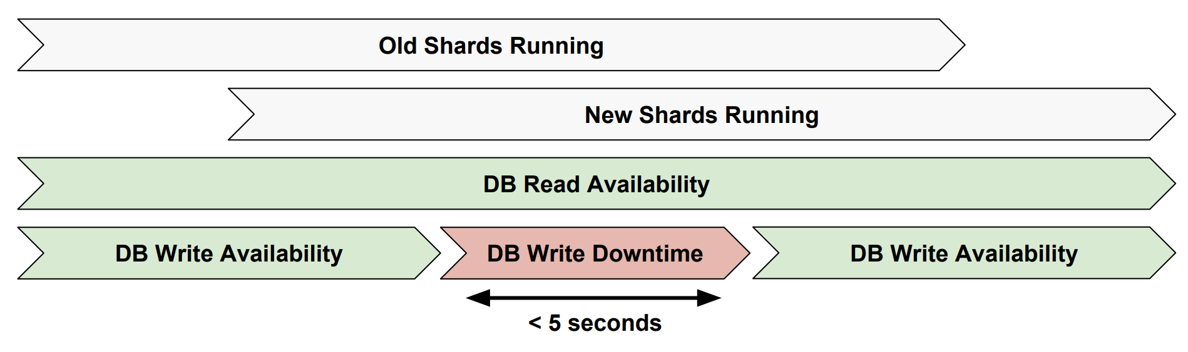
Vitess https://github.com/youtube/vitess
https://freo.me/vitess-pres

Slide 15
In Memory Databases
Memory is relatively much cheaper than it used to be
Uses snapshots or transaction logs to ensure durability
Some NoSQL, some NewSQL
SAP Hana
Redis
VoltDB
MemSQL
Apache Geode

Slide 16
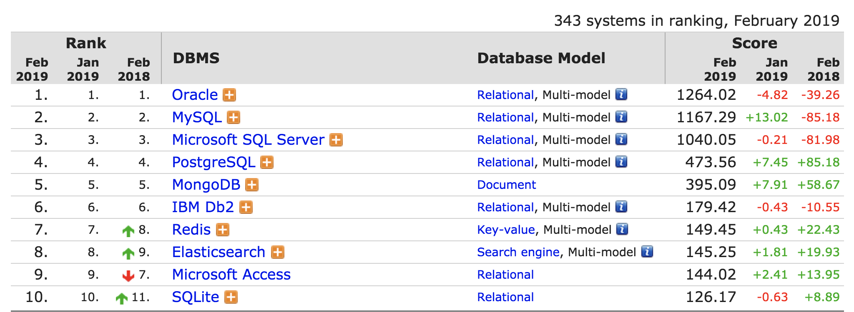
Top ten databases 2019
ranked by popularity:
number of results in web searches
Stack Overflow & DBA Stack Exchange
Google Trends
job advertisements
professional networks
social networks
http://db-engines.com/en/ranking

Slide 17
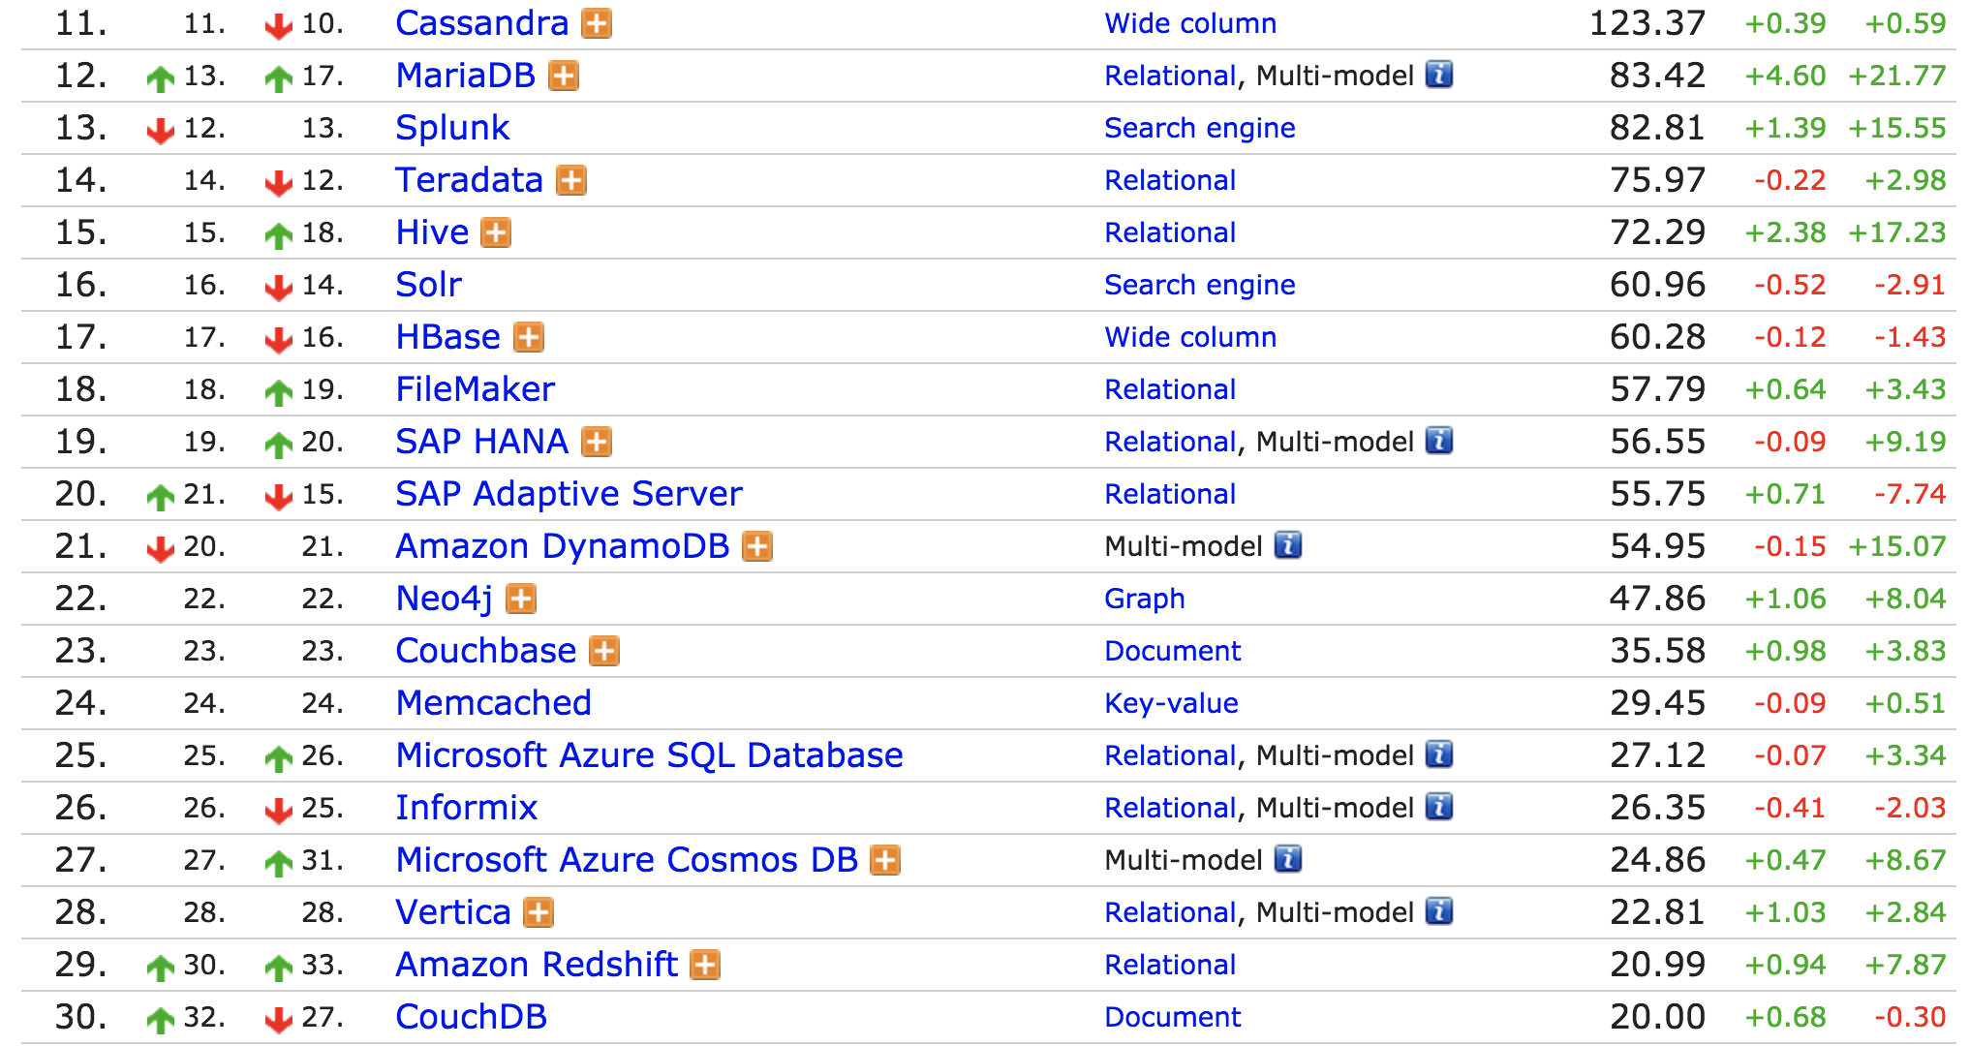
Next 20

Slide 18
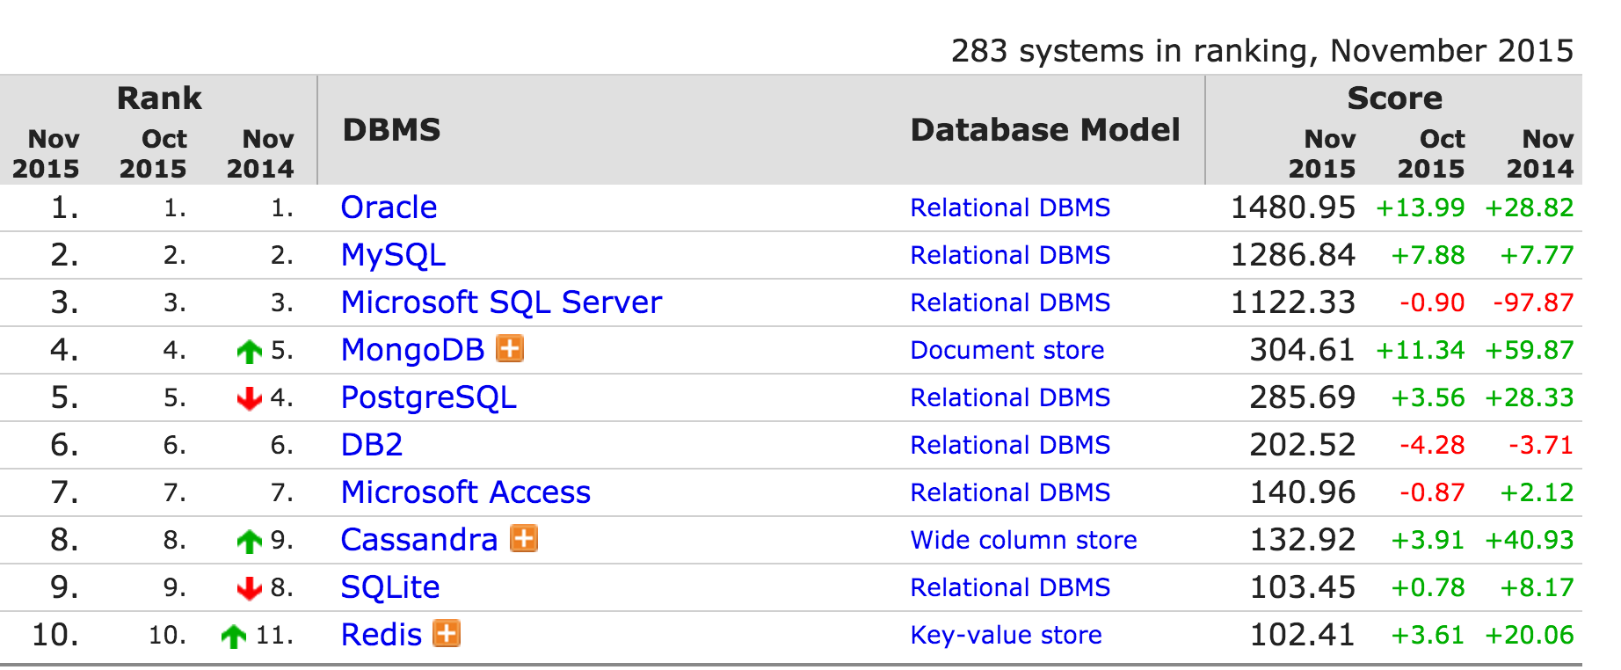
Top ten databases 2015
http://db-engines.com/en/ranking

Slide 19
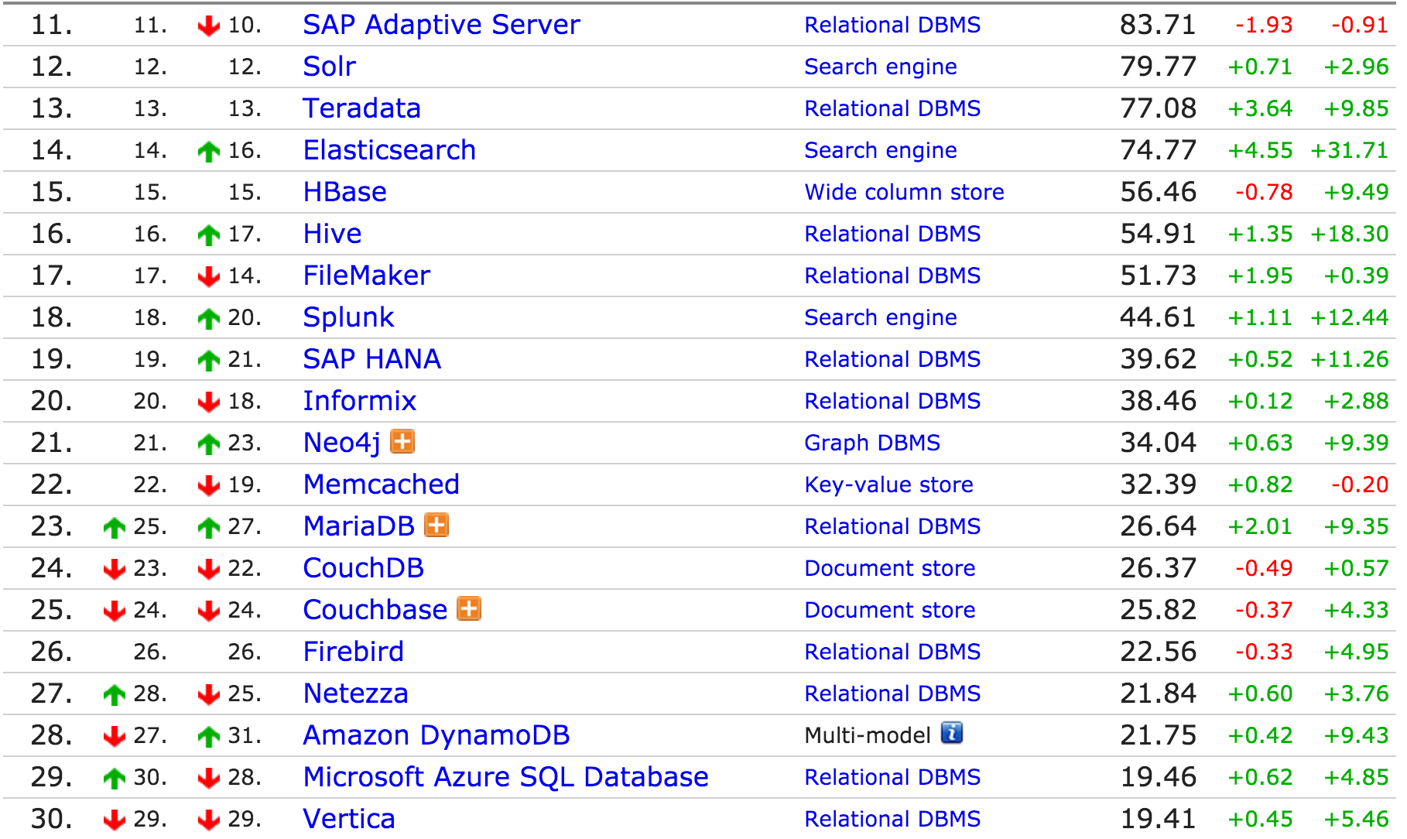
Next 20

Slide 20
2015 → 2019
Gaining popularity
Losing popularity
Redis
Elasticsearch
Splunk
key-value
Cassandra
Hbase
wide column stores
search engine
Relational databases (e.g., SQL) still seem dominant

Slide 21
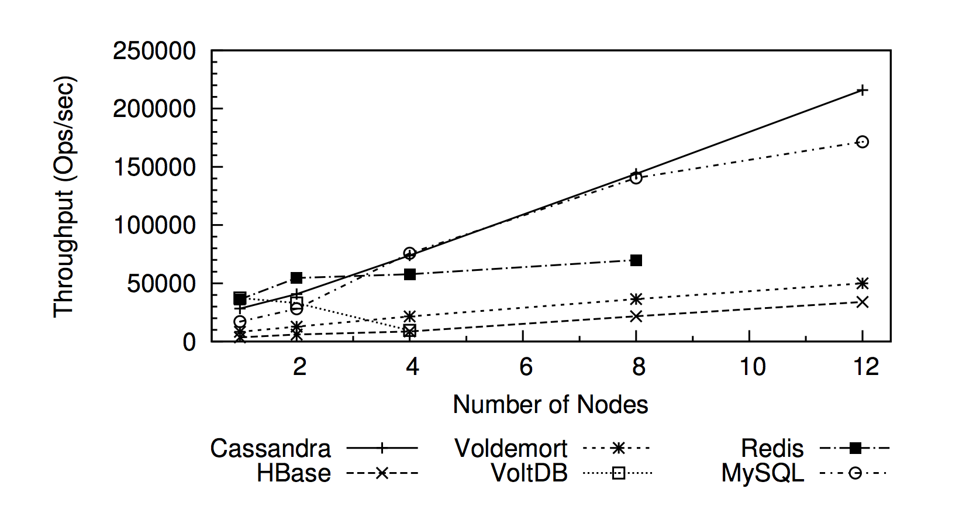
Performance (2012) 50%/50% reads/writes
Rabl, Tilmann, et al. "Solving big data challenges for enterprise application performance management." Proceedings of the VLDB Endowment 5.12 (2012): 1724-1735.

Slide 22
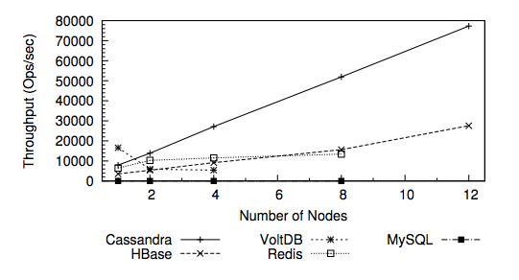
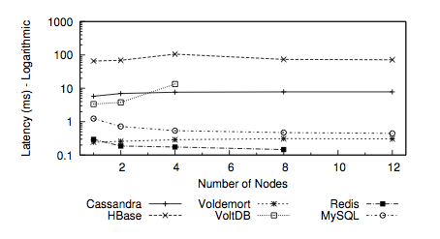
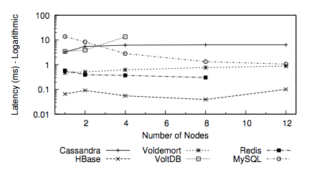
More performance (2012) Read/Scan/Write workload
Throughput
Read Latency
Write Latency

Slide 23
Summary of Performance benchmark (2012)
Cassandra had the best throughput but high latency
Voldemort had the best and most stable latency but lower throughput
HBase had low performance per node but scaled well
Low write latency
Redis, MySQL and VoltDB did not scale as well in multi-node setups

Slide 24
Key Value databases
A persistent associative array or dictionary
Simple access and fits well with programming models (especially MR)
Indexing on other data is not often possible and can be slow

Slide 25
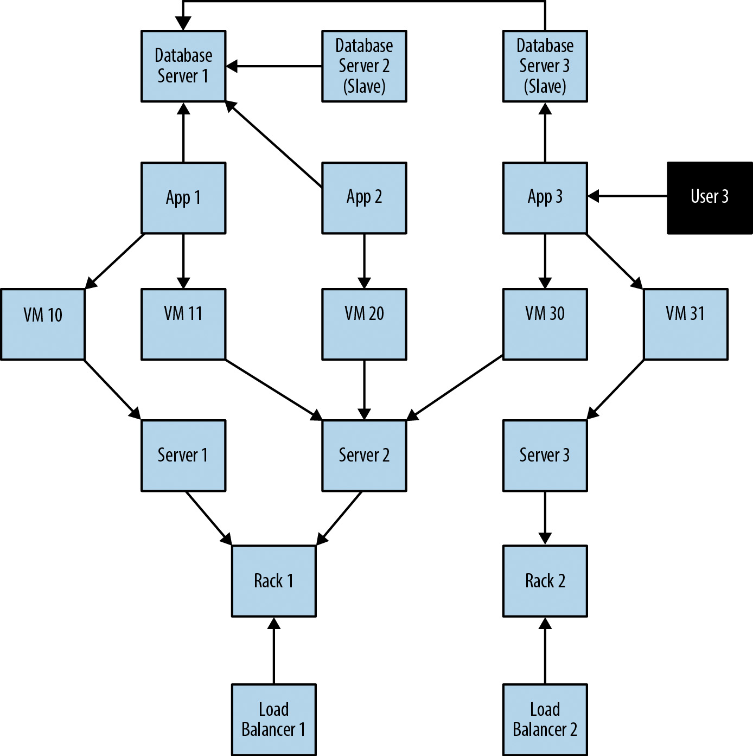
Graph Databases
Source: neo4j

Slide 26
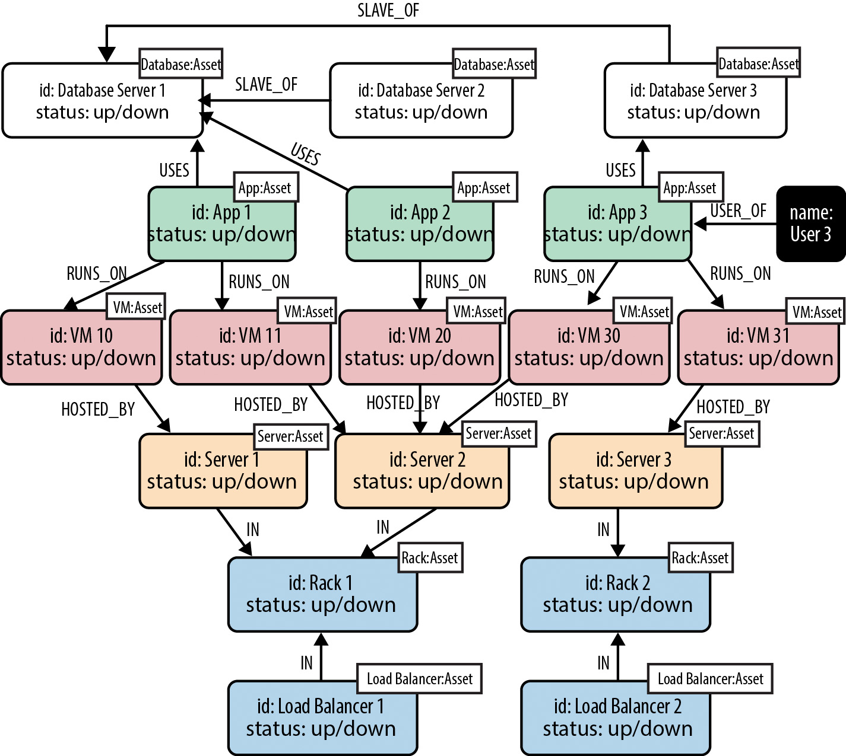
Graph Database mapping
Source: neo4j

Slide 27
Apache Cassandra
Masterless / Symmetric
Every node is equal and you can write to any node as well as read
Shared Nothing architecture
Each server has its own disk
Based on Dynamo
for automatic sharding and eventual consistency
And BigTable
For “Column Families”
Donated to Apache by Facebook
Now mostly developed by DataStax

Slide 28
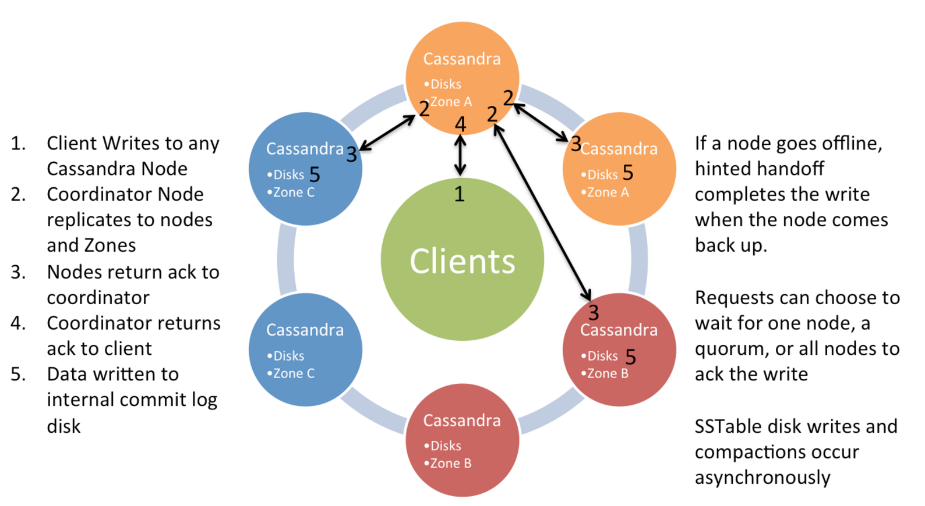
Cassandra Write Model Single Datacentre
Source: Netflix

Slide 29
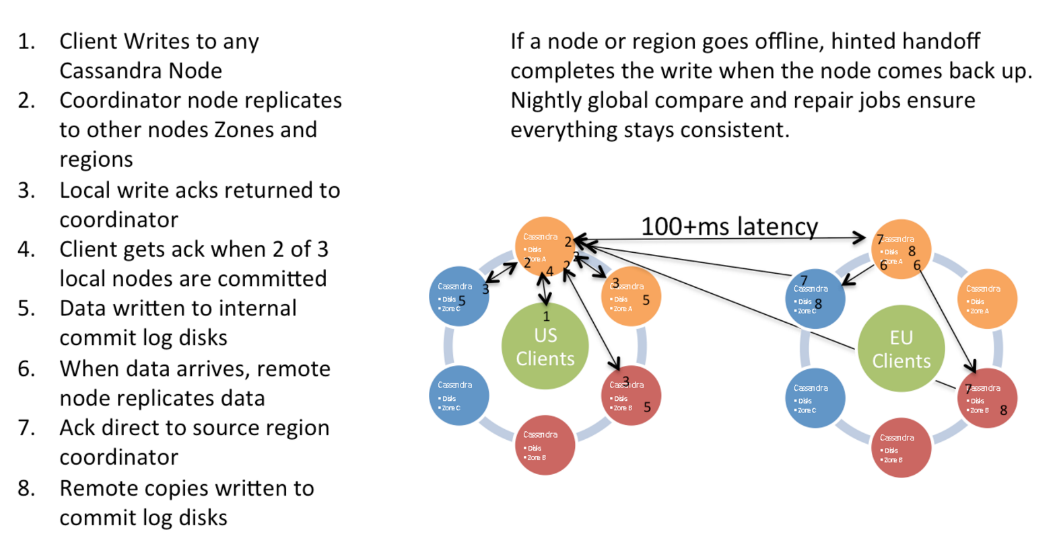
Multi Datacentre Writes
Source: Netflix

Slide 30
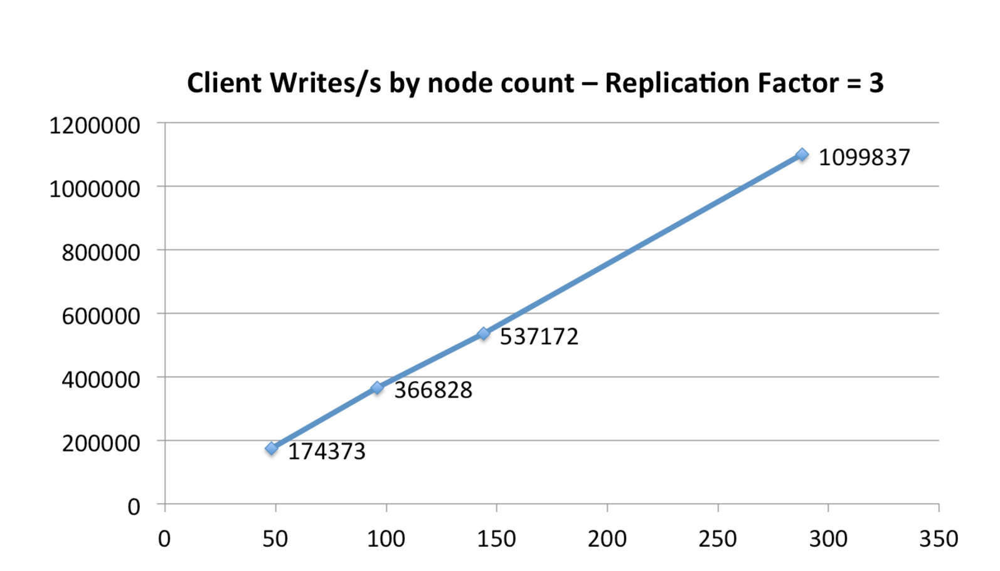
Cassandra Scale Up In Amazon EC2
Source: Netflix

Slide 31
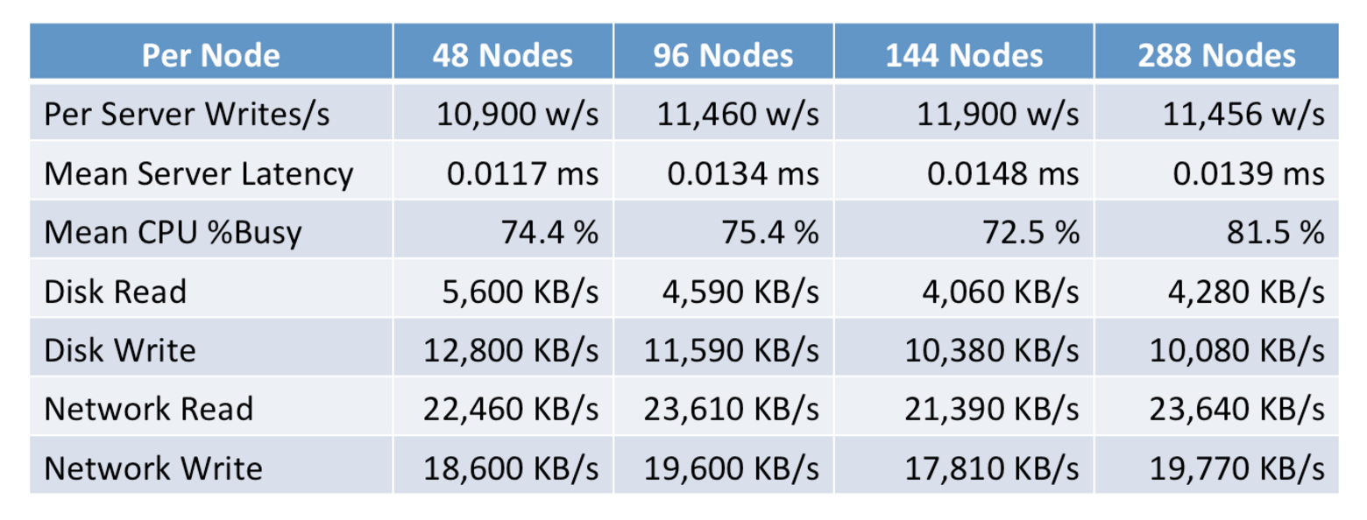
The numbers
Source: Netflix

Slide 32
Cassandra Model
Keyspaces are roughly equivalent to SQL Databases
Encapsulate replication strategies
Column Families roughly equivalent to SQL tables
Generally a different approach vs SQL
Writes are cheap
Indexes are expensive
Normalization is not the goal

Slide 33
Cassandra Model cont.
Inserts are the same as updates
No read first
Data can be marked with a Time to Live (TTL)
Automatically deleted
Deletes are not instant
Deleted rows are marked with a tombstone
Eventually cleaned up
Can re-appear if you do not run node repair after a node failure

Slide 34
CQL
A variant of SQL written specifically for Cassandra
The preferred model of access
Replaces the old “Thrift” API
Attempts to have some compatibility with normal SQL
e.g. you can use either KEYSPACE or TABLE interchangeably

Slide 35
CQL examples
SELECT name, occupation FROM users WHERE userid IN (199, 200, 207);
However, some queries are not permitted:
SELECT firstname, lastname FROM users WHERE birth_year = 1981 AND country = 'FR';
Requires a large scan of the database and cannot give a predictable time response:
ALLOW FILTERING will make this run anyway

Slide 36
INSERT / UPDATE
INSERT INTO NerdMovies (movie, director, main_actor, year)
VALUES ('Serenity', 'Joss Whedon', 'Nathan Fillion', 2005)
USING TTL 86400;
Every row can have a specified expiry time
Inserts work even if the data is already there, unless you specify:
INSERT INTO NerdMovies (movie, director, main_actor, year)
VALUES ('Serenity', 'Joss Whedon', 'Nathan Fillion', 2005) IF NOT EXISTS
USING TTL 86400;
This can have unpredictable timing because it requires read-before-write

Slide 37
Non-SQL data types
Sets
CREATE TABLE cycling.cyclist_career_teams ( id UUID PRIMARY KEY, lastname text, teams set<text> );
Lists
CREATE TABLE cycling.upcoming_calendar ( year int, month int, events list<text>, PRIMARY KEY ( year, month) );
Maps
CREATE TABLE cycling.cyclist_teams ( id UUID PRIMARY KEY, lastname text, firstname text, teams map<int,text> );
Tuples
CREATE TABLE cycling.popular (rank int PRIMARY KEY, cinfo tuple<text,text,int> );

Slide 38
Direct support for JSON
INSERT INTO cycling.cyclist_category JSON '{
"category" : "GC",
"points" : 780,
"id" : "829aa84a-4bba-411f-a4fb-38167a987cda",
"lastname" : "SUTHERLAND" }';

Slide 39
cassandra.yaml
Configuration of the major parts of the system
Datacentres, Racks, Cluster name
Authentication and Authorization
Partitioner
Data Storage location
Cacheing
Network topology and ports
Etc, etc

Slide 40
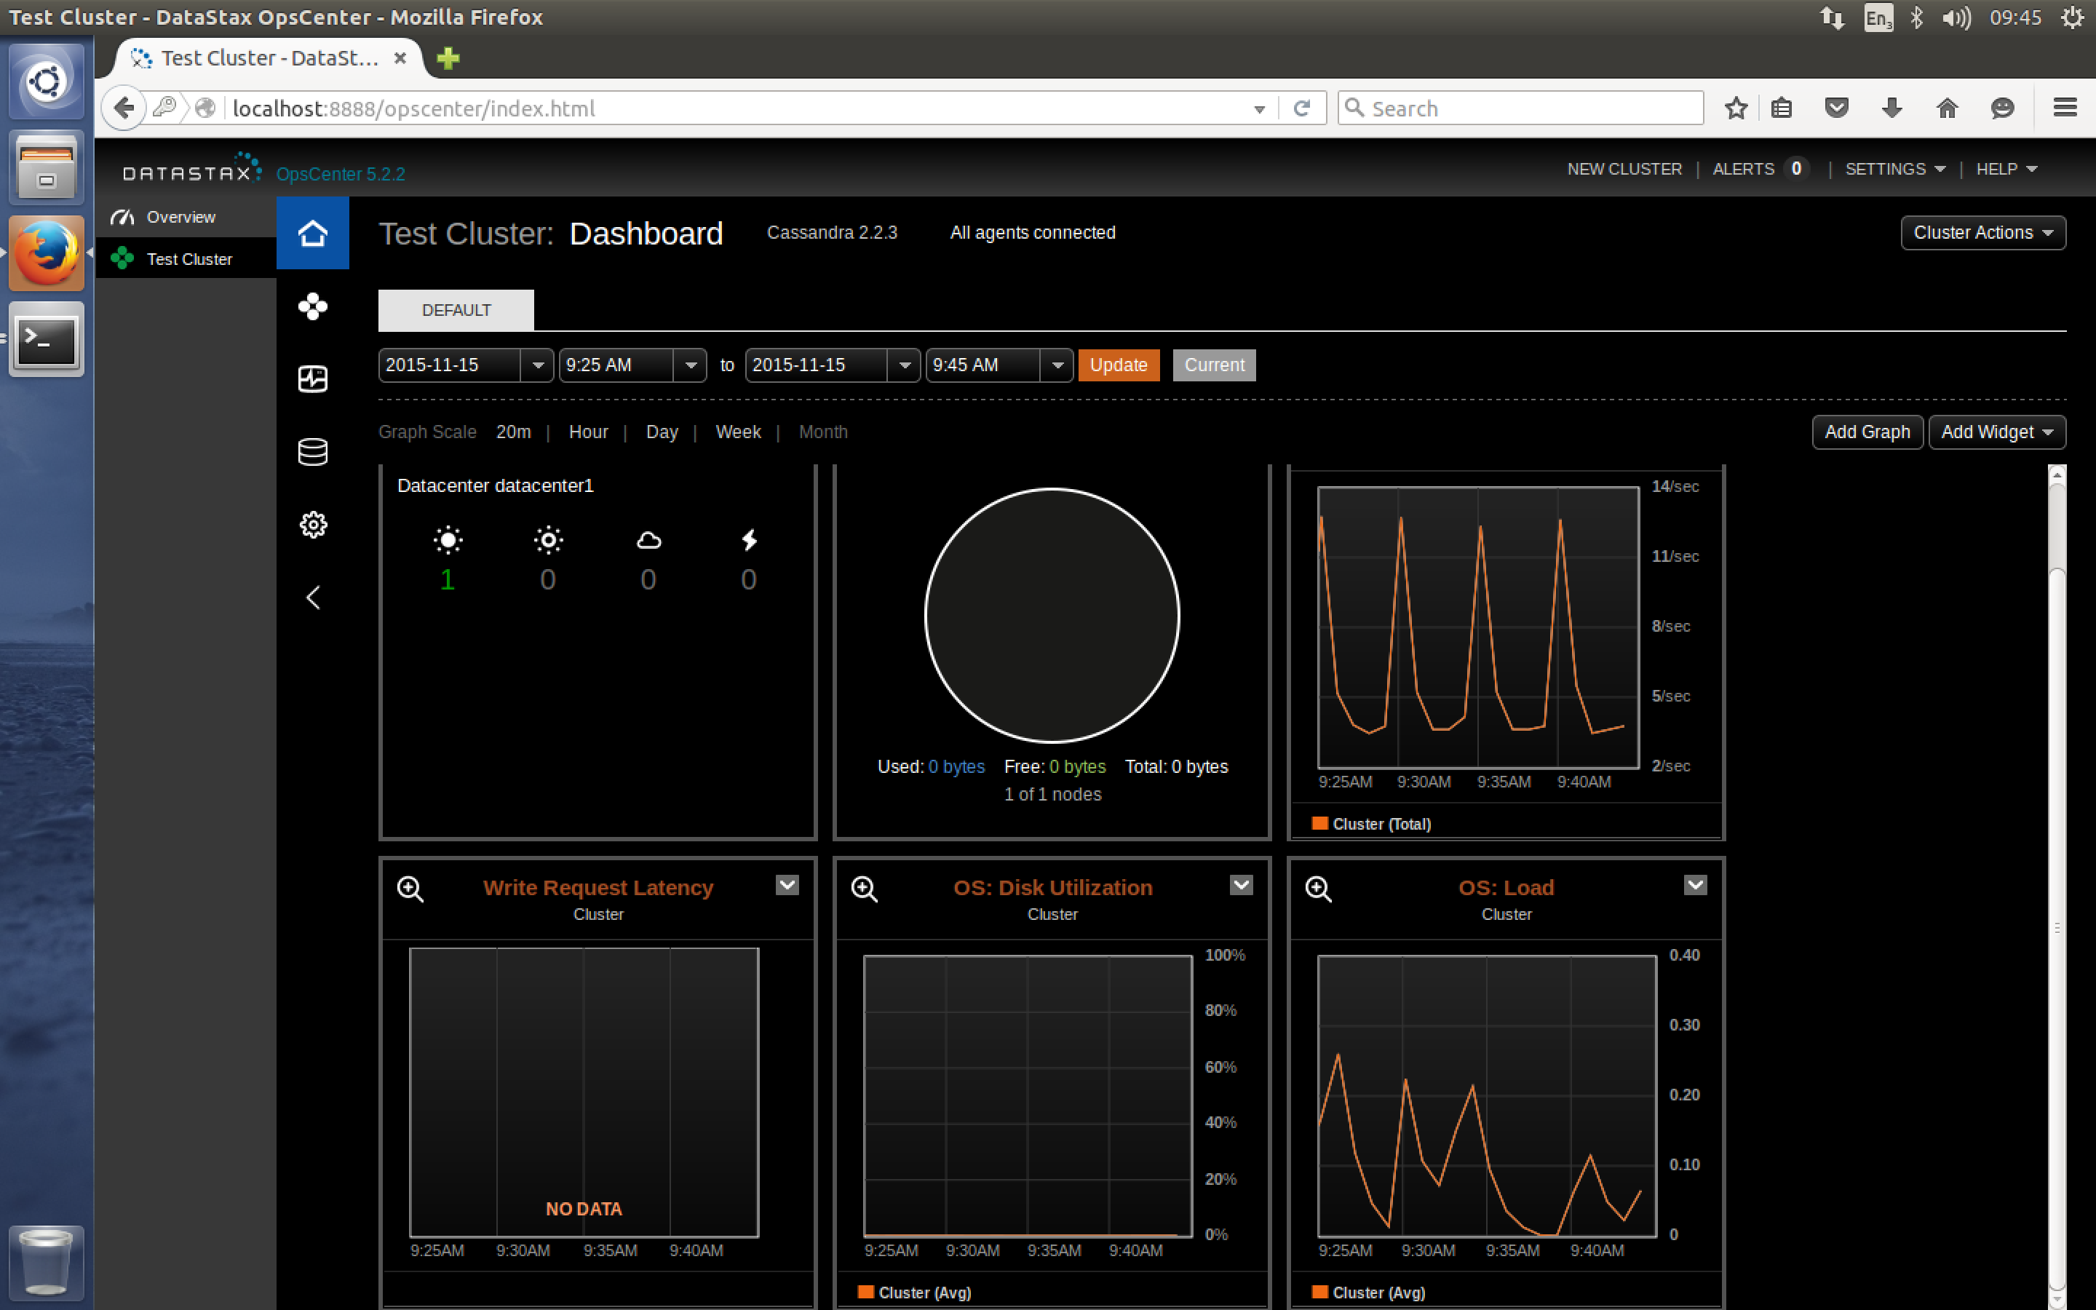
DataStax OpsCenter

Slide 41
OpsCenter
Part of DataStax Cassandra distribution
Community edition has limited features
Enterprise edition expands these
Not open source, but free to use in the community edition
Requires an agent on each Cassandra node
It will install this via SSH if possible

Slide 42
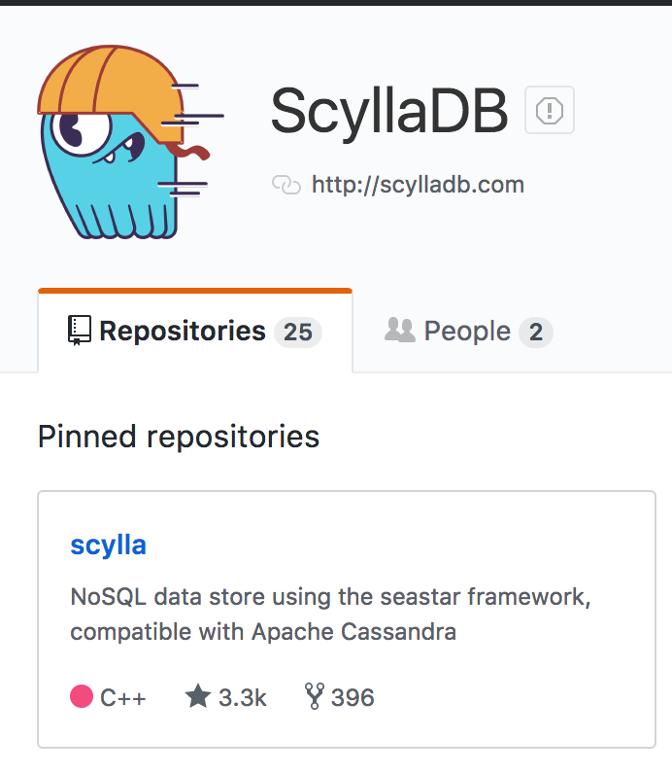
ScyllaDB
A C++ “clone” of Cassandra
Also Open Source
Claims to be significantly faster

Slide 43
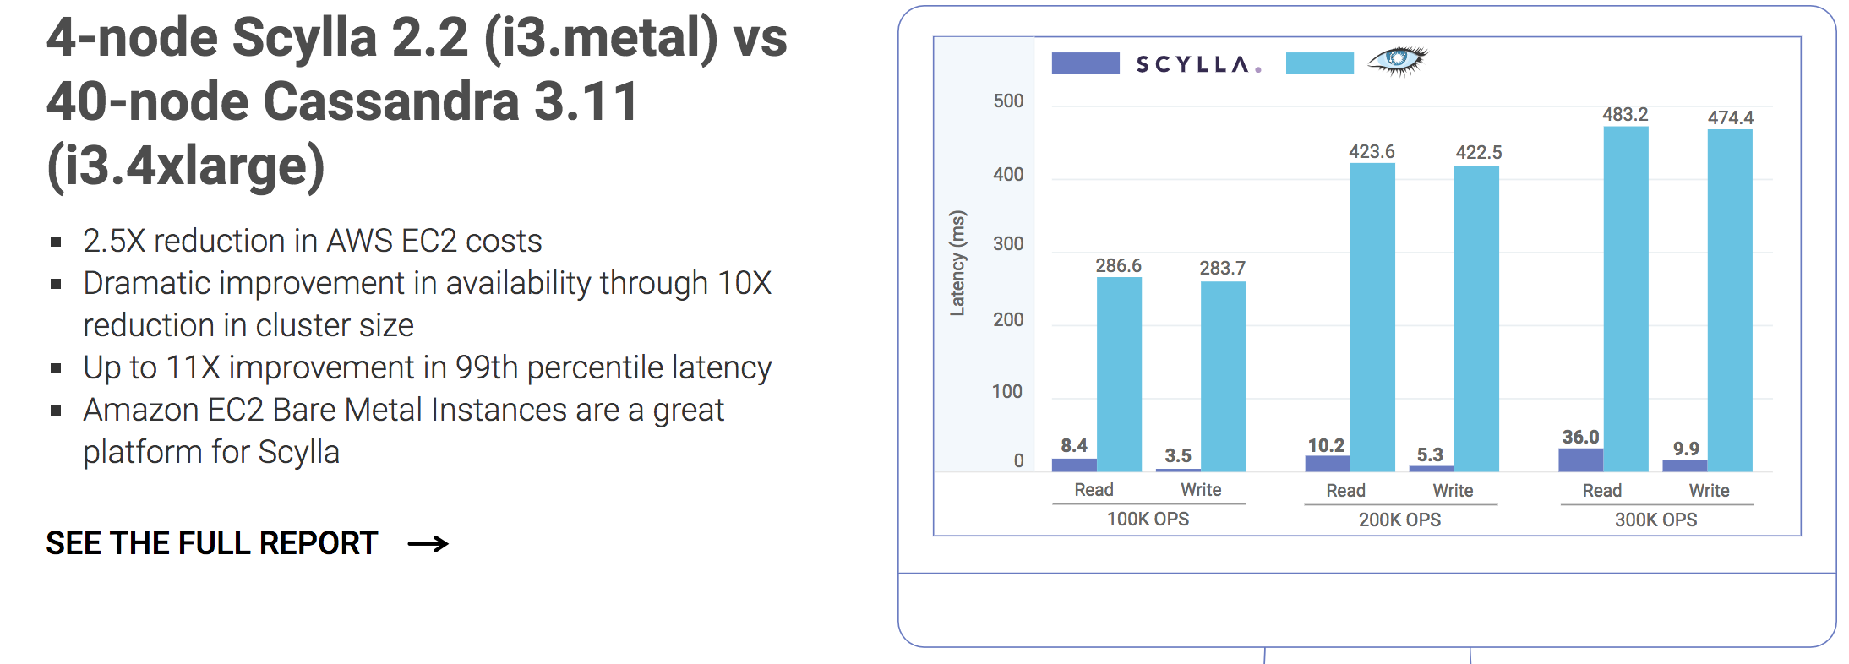
Scylla vs Cassandra

Slide 44
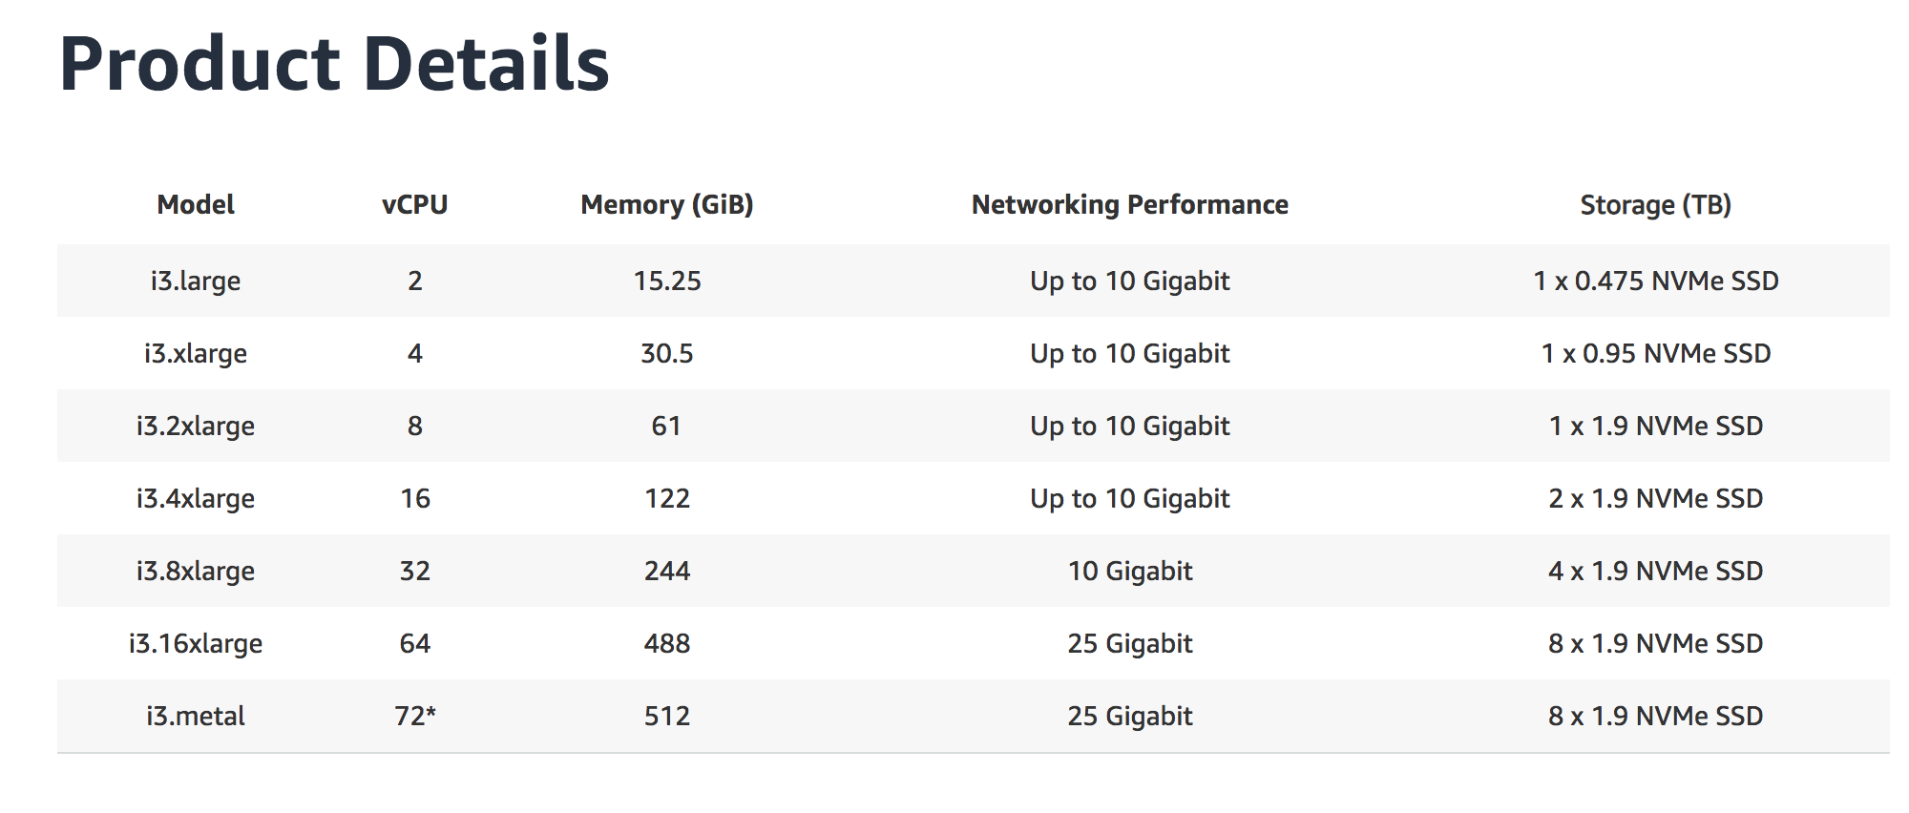
Amazon EC2 I3 Instances
Storage opti,mised for high transaction workloads

Slide 45
Questions?

